Slide 1
Air Aware – Smart Air Quality Prediction System
Name: S. Sneha
Infosys Springboard Internship
Group:2

Slide 2
Project overview
Air Aware is a smart system designed to analyze air pollutants and predict AQI.
Uses a machine learning model trained on PM2.5, CO, NO₂, and AQI datasets.
Includes a clean frontend UI and Flask backend integration.
Provides trend graphs, predicted values, and downloadable PDF reports

Slide 3
Problem Statement
Air pollution levels are rising due to urbanization and climate change.
People don't have simple tools to check real-time AQI.
This makes health and outdoor activity decisions difficult.
Air Aware solves this by providing AQI prediction using ML + dashboard UI.

Slide 4
Features
Real-time input-based AQI prediction.
Line & Bar charts for trend visualization.
City-wise pollutant analysis.
Downloadable AQI report (PDF).
Clean and responsive UI.
ML model trained on Indian air-quality dataset.

Slide 5
Frontend (HTML, CSS, JS)
Built using HTML5 + CSS3.
Smooth navigation bar & user-friendly layout.
Charts created using Chart.js.
JavaScript fetch() used to connect with backend.
Four pages: Home, Dashboard, About, Contact.

Slide 6
Backend
Flask used for routing and server handling.
/predict endpoint processes data to returns predicted AQI.
ML model loaded via pickle (aqi_model.pkl).
/download_report generates PDF using FPDF.
Dataset: City-Day Air Quality Dataset.
Columns: PM2.5, CO, NO₂, AQI.

Slide 7
Tech Stack
Frontend: HTML, CSS, JavaScript, Chart.js used to build UI and charts
Backend: Python Flask used to handle routing and backend logic
Machine Learning: pandas, Numpy used for data preprocessing and prediction
Dataset: City-Day air quality dataset used to train AQI model
PDF Generation: FPDF used to generate downloadable AQI reports
Version Control: GitHub used for maintaining project versions

Slide 8
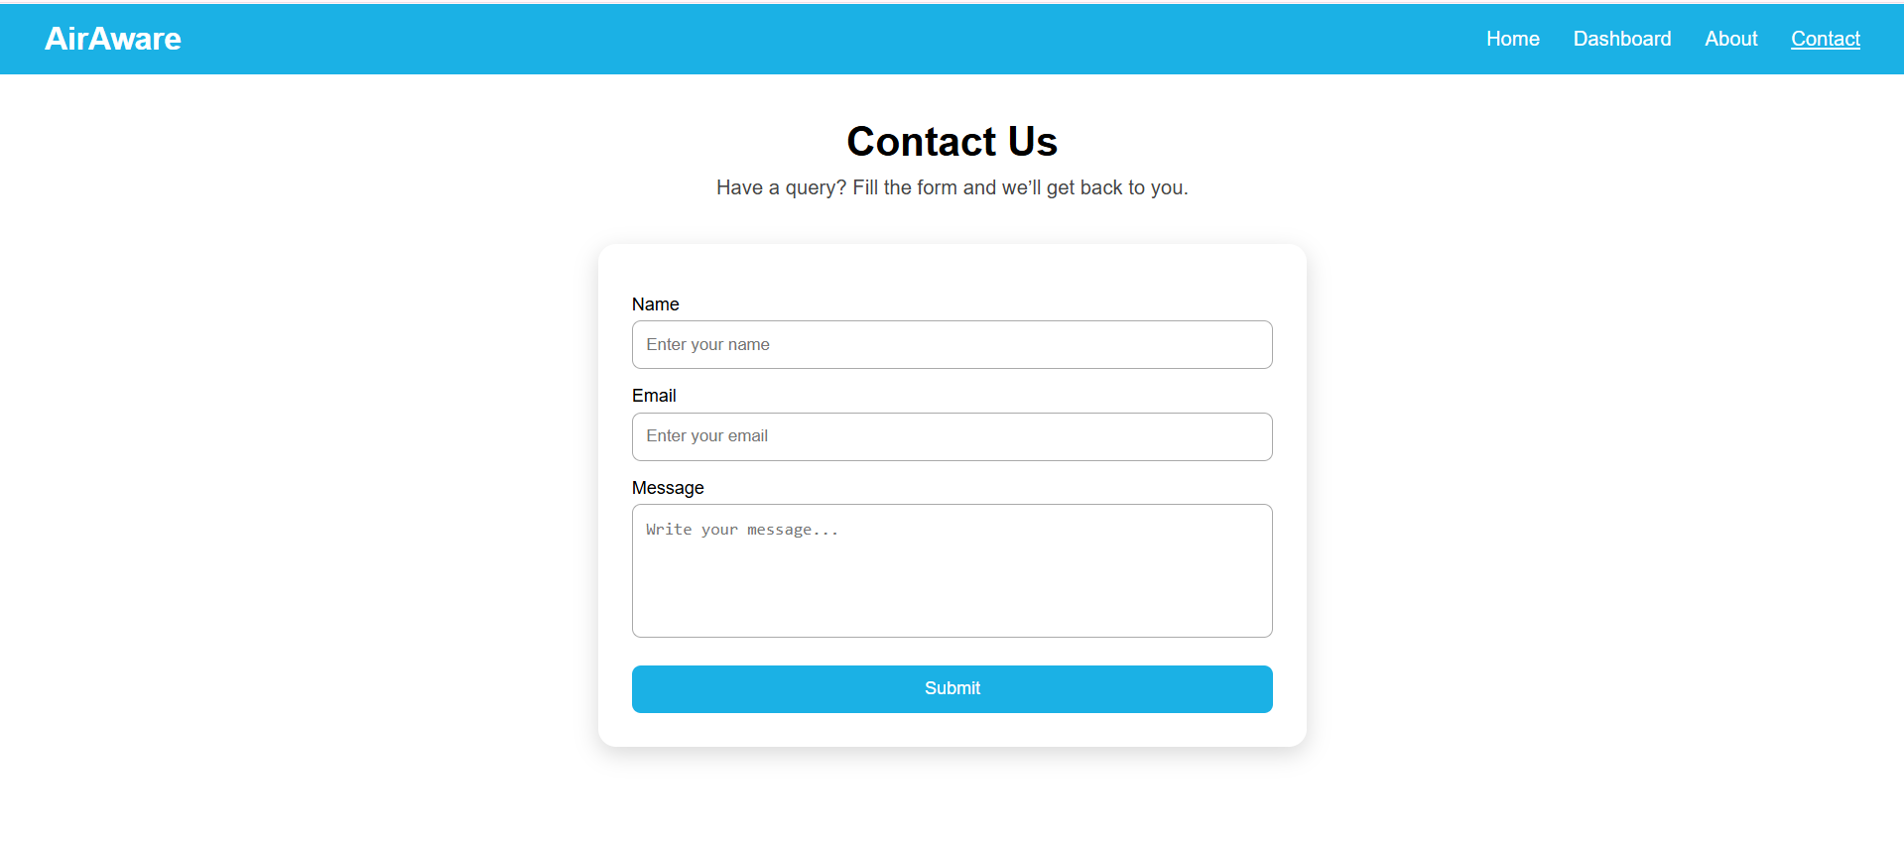
CONTACT PAGE

Slide 9
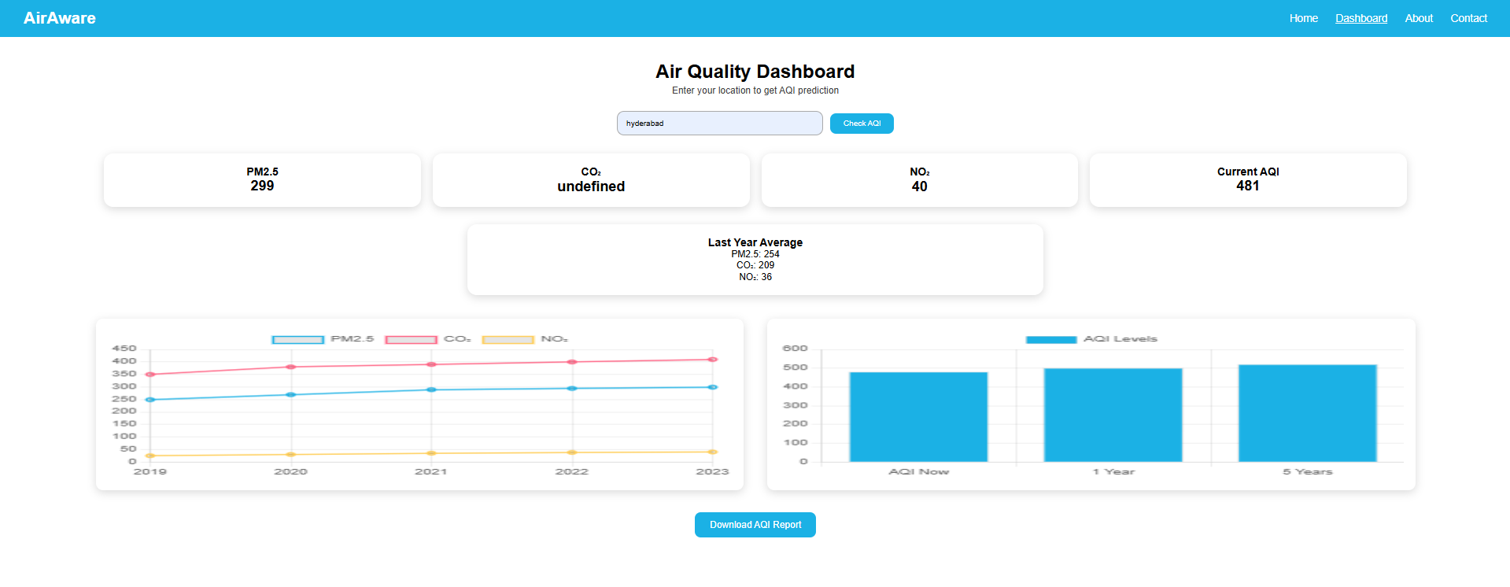
DASHBOARD PAGE
The Dashboard is the main functional page where users can enter a location and view predicted AQI values.
It displays pollutant levels (PM2.5, CO₂, NO₂), last-year averages, and visual charts using Chart.js. Users can also download a detailed PDF report of the predicted air quality.

Slide 10
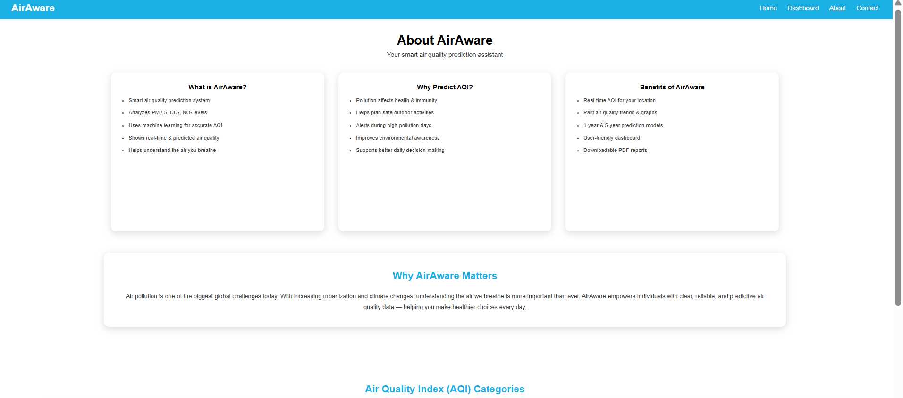
About page

Slide 11
Conclusion & Future Scope
Conclusion:
This project demonstrates a complete air-quality prediction system with a functional UI, backend APIs, and a trained ML model.
Future Scope:
Integration of real sensor APIs
Multi-city comparative predictions
Dark mode implementation
Deploying

